Slide 1
PROJECT PRESENTATION BY MOHAMMED AZEEZ
PROJECT: Assistance to Amputees for creating bass accompaniments
CDA 6316 -001: Embedded Systems Design 1

Slide 2
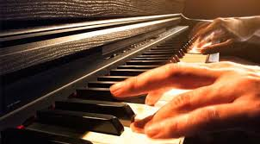
So what if an individual with a physical impairment of lacking one arm (example the left arm) wants to the play the keyboard ?
Can any solutions be offered even if it is limited ?

Slide 3
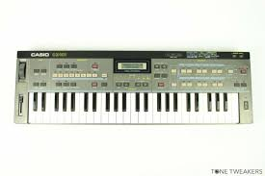
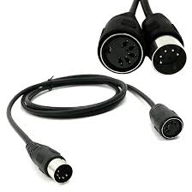
We can propose a solution to this problem with MIDI KEYBOARDS:

Slide 4
PROPOSED SOLUTION
1) The proposed solution is to offer bass notes accompaniments in different modes to the chords played
2) For example if the pianist with her right hand is playing a Cmajor chord ( C₆ E₆ G₆ ) , with her left hand she adds some bass notes such as (C_{­­­­­­­­­­­­­­­­­­­­­­­­­4} and G₄ ) to give the chord a better and complete feeling.
3) What is proposed is to help an AMPUTEE automatically generate those bass notes C_{­­­­­­­­­­­­­­­­­­­­­­­­­4} and G₄

Slide 5
PROPOSED SOLUTION pt2 : BUILD A DEVICE THAT CAN DO THE FOLLOWING TASKS
1) Read the notes played in input
2) Process those notes and decide the correspondent bass note
3) Play the established bass note(s)
4) Realize all of these in the frame of milliseconds to guarantee real-time experience

Slide 6
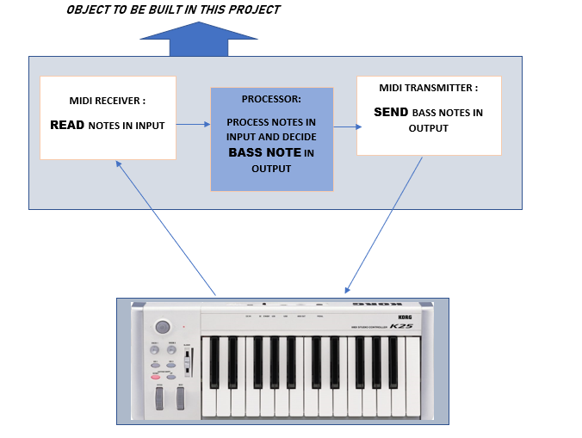
DIAGRAM OF THE SOLUTION

Slide 7
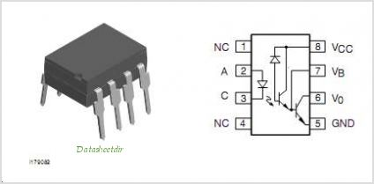
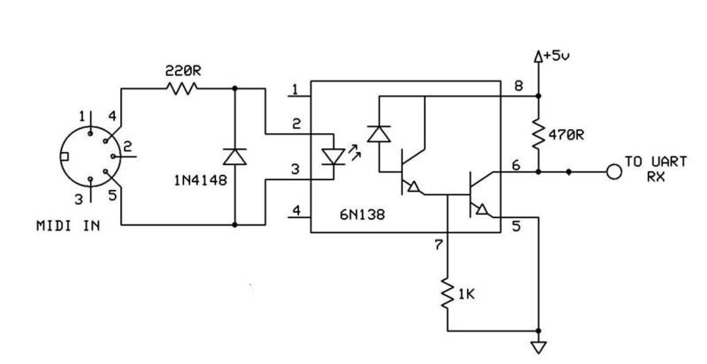
MIDI RECEIVER
Below is the schematics for receiving the midi :

Slide 8
MIDI RECEIVER
The midi signal is received through an optocoupler and sent to the microcontroller’s RX PIN
The data sent is transcribed into the state of the transistor’s collector(inside the optocoupler) that can be measured from one of the optocoupler’s pins.
Below is the optocoupler used

Slide 9
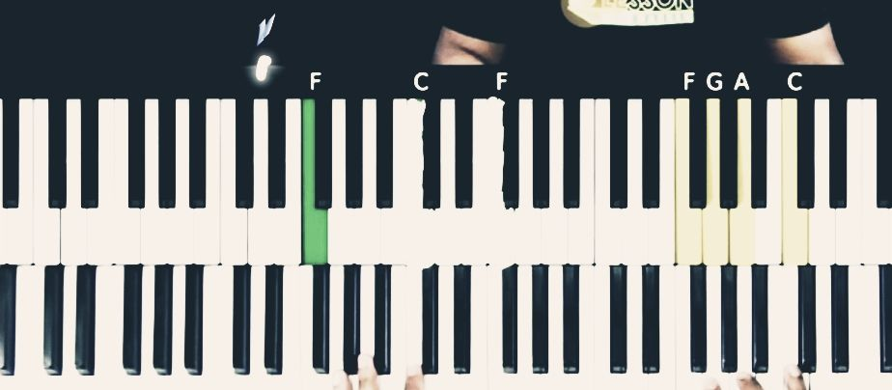
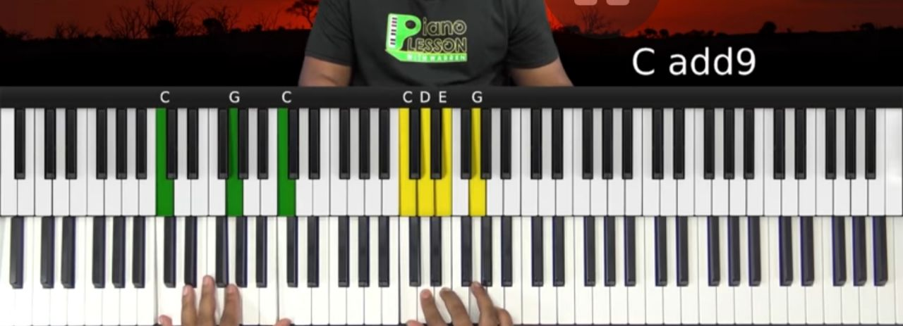
THE PROCESSOR
Based on the notes read in input, the processor decides the bass note.
There are two possible modes of operation : singular bass note or multiple bass notes
The choice of mode and the octave of the bass note is achieved through a keypad incorporated to the device
1ST MODE
2ND MODE

Slide 10
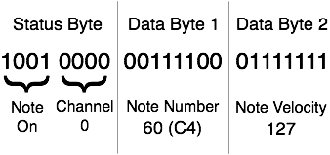
THE PROCESSOR IS BASED ON THE MIDI PROTOCOL !
Midi operates at a baud rate of 31250 bits/second
Traditional MIDI messages are sent as a time sequence of 3 bytes (1byte = 8 bits).
The first byte is a STATUS byte, often followed by 2 DATA bytes.
STATUS BYTE = 1XXXCCCC with 1XXX = note on OR off message, CCCC = channel number
1st DATA BYTE =0YYYYYYY = Note number for example middle C₃ note number is 48
2nd DATA BYTE = 0ZZZZZZ =Velocity of the note, it describes how hard the note was pressed
So a when a note is pressed, 3 bytes from the keyboard are received and when the note is released 3 further bytes are received .
Example of midi message

Slide 11
THE PROCESSOR CONTAINS A CHORD IDENTIFICATION ALGORITHM
The chord identification algorithm is only able to identify minor chords and major chords
When there is a note on command, every note played is saved in an array, when the notes played represent a chord, the bass note is computed through the chord identification algorithm .
The Algorithm returns the index of the array corresponding to the root note of the chord, for example if the chord played is a Gmajor chord (G D B), the algorithm returns the position in which the note G is in.
Depending on the mode chosen (multiple or singular) the bass note is computed with the formula : bass_note = root_note – (12 X octave_selected )
If mode 1 was selected, bass_note is a singular note
if mode 2 was selected, the multiple bass notes are computed and saved in array till octave_selected decrements to zero.

Slide 12
COMMUNICATION OF DATA IS ACHIEVED VIA SERIAL COMMUNICATION
The array or variable representing the bass note is then written to the microcontroller’s serial port through the "Serial.write( ARRAY, array_size)” function
This means the information is written to the RX PIN of the microcontroller.

Slide 13
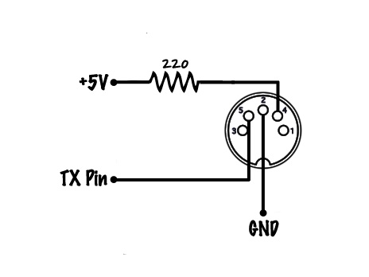
MIDI TRANSMITTER
To send the bass_note data from the TX pin to a midi device, the following schematic was employed

Slide 14
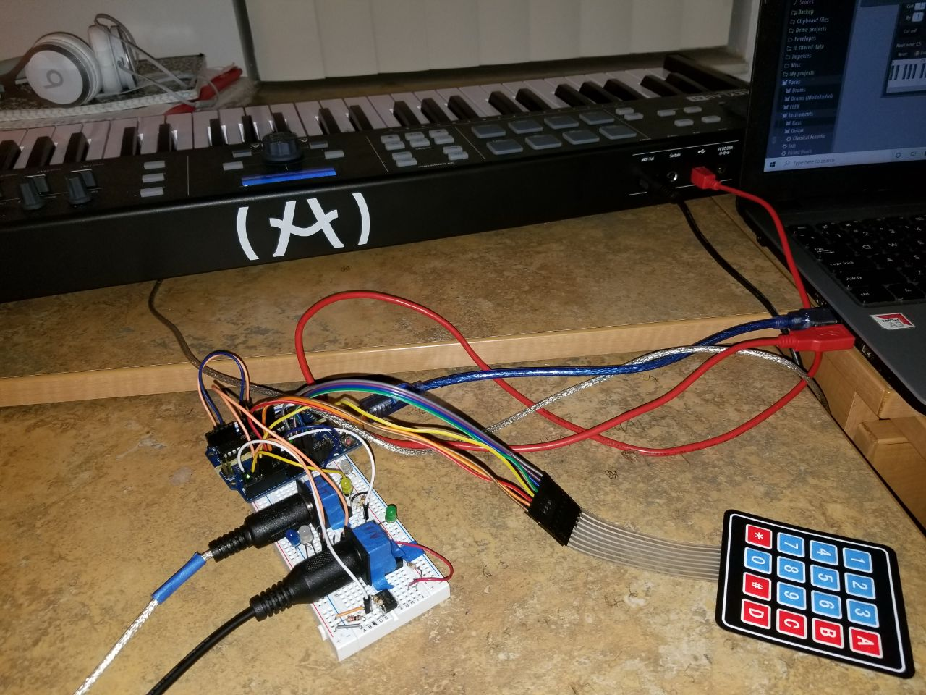
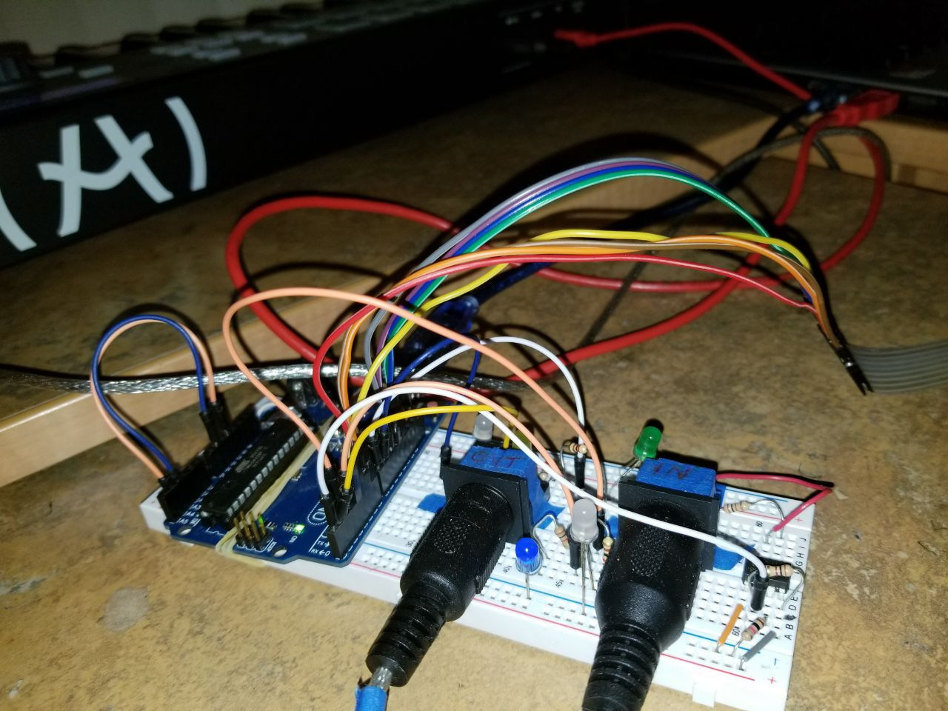

Slide 15
Here we go ! Technology making life better
Building this project was very fun and interesting, the whole experience helped gain steadiness, deep understanding and problem resolution skills from in various engineering fields.

